Slide 1
scRNA seq data analysing tools
Niels Vanneste

Slide 2
DESeq2
EdgeR
Monocle2
SCDE

Slide 3
Dataset
scRNA seq
Single-Cell Transcriptome Profiling of Human Pancreatic Islets in Health and Type 2 Diabetes
Segerstolpe et al.

Slide 4
Workflow
FastQC
STAR
HTSeq-Count
DE tools

Slide 5
DESeq2
Bulk RNA-seq
Bad clustering
High FDR

Slide 6

Clustering DESeq 2

Slide 7
EdgeR
scRNA

Slide 8
Clustering edgeR

Slide 9
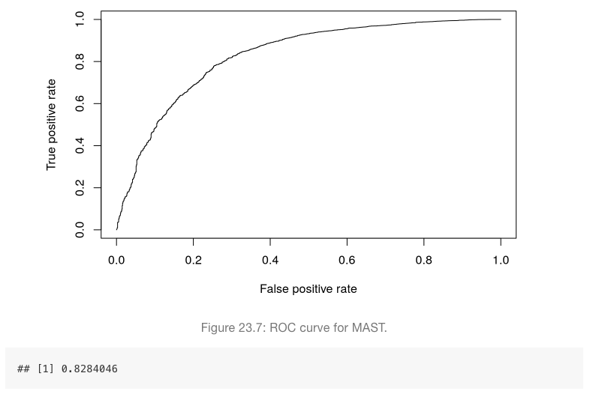
EdgeR
82,48 % TPR

Slide 10
Monocle2
scRNA

Slide 11
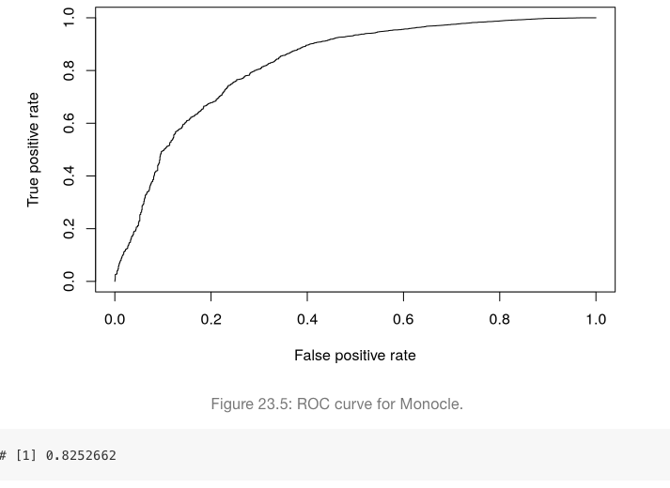
Monocle2

Slide 12
SCDE
scRNA
R version 3.3.0
Small datasets

